Slide 1
Application of Survival Analysis in Retail Clearance
Smaranya Dey & Gayatri Pal

Slide 2
Agenda
01
What is Survival Analysis? What is clearance in retail industry?
02
How to use such techniques to solve use cases in clearance?
03
Why is it important?

Slide 3
“Data Rich, Information Poor”

Slide 4
Application Areas of Survival Analysis
Domain | Event of Interest | Estimation | Features
Healthcare [Miller Jr 2011] [Reddy and Li 2015] | Re-hospitalization, Disease recurrence, Cancer survival | Likelihood of hospitalization within t days of discharge | Demographics: age, gender, race. Measurements: height, weight, disease history, disease type, treatment, comorbidities, laboratory, procedures, medications
Reliability [Lyu 1996] [Modarres et al. 2009] | Device failure | Likelihood of a device being failed within t days. | Product: model, years after production, product performance history. Manufactory: location, no. of products, average failure rate of all the products, annual sale of the product, total sale of the product. User: user reviews of the product.
Crowdfunding [Rakesh et al. 2016] [Li et al. 2016a] | Project success | Likelihood of a project being successful within t days. | Projects: duration, goal amount, category. Creators: past success, location, no. of projects. Twitter: no. of promotions, backings, communities. Temporal: no. of backers, funding, no. of retweets.
Bioinformatics [Li et al. 2016d] [Beer et al. 2002] | Cancer survival | Likelihood of cancer within time t. | Clinical: demographics, labs, procedures, medications. Genomics: gene expression measurements.
Customer Lifetime Value [Zeithaml et al. 2001] [Berger and Nasr 1998] | Purchase behaviour | Likelihood of a customer purchasing from a given service supplier within t days. | Customer: age, gender, occupation, income, education, interests, purchase history. Store/Online store: location, customer review, customer service, price, quality, shipping fees and time, discount.
Click Through Rate [Yin et al. 2013] [Barbieri et al. 2016] | User clicking | Likelihood of a user clicking the advertisement within time t. | User: gender, age, occupation, interests, users click history. Advertisement (ad): time of the ad, location of the ad on the website, topics of the ad, ad format, total click times of the ad. Website: no. of users of the website, page view each day of the website, no. of websites linking to the website.
Source

Slide 5
Application Areas of Survival Analysis
Domain | Event of Interest | Estimation | Features
Healthcare [Miller Jr 2011] [Reddy and Li 2015] | Re-hospitalization, Disease recurrence, Cancer survival | Likelihood of hospitalization within t days of discharge | Demographics: age, gender, race. Measurements: height, weight, disease history, disease type, treatment, comorbidities, laboratory, procedures, medications
Reliability [Lyu 1996] [Modarres et al. 2009] | Device failure | Likelihood of a device being failed within t days. | Product: model, years after production, product performance history. Manufactory: location, no. of products, average failure rate of all the products, annual sale of the product, total sale of the product. User: user reviews of the product.
Crowdfunding [Rakesh et al. 2016] [Li et al. 2016a] | Project success | Likelihood of a project being successful within t days. | Projects: duration, goal amount, category. Creators: past success, location, no. of projects. Twitter: no. of promotions, backings, communities. Temporal: no. of backers, funding, no. of retweets.
Bioinformatics [Li et al. 2016d] [Beer et al. 2002] | Cancer survival | Likelihood of cancer within time t. | Clinical: demographics, labs, procedures, medications. Genomics: gene expression measurements.
Customer Lifetime Value [Zeithaml et al. 2001] [Berger and Nasr 1998] | Purchase behaviour | Likelihood of a customer purchasing from a given service supplier within t days. | Customer: age, gender, occupation, income, education, interests, purchase history. Store/Online store: location, customer review, customer service, price, quality, shipping fees and time, discount.
Click Through Rate [Yin et al. 2013] [Barbieri et al. 2016] | User clicking | Likelihood of a user clicking the advertisement within time t. | User: gender, age, occupation, interests, users click history. Advertisement (ad): time of the ad, location of the ad on the website, topics of the ad, ad format, total click times of the ad. Website: no. of users of the website, page view each day of the website, no. of websites linking to the website.
Event of interest
Time period
Likelihood of the occurrence of event within time
Source

Slide 6
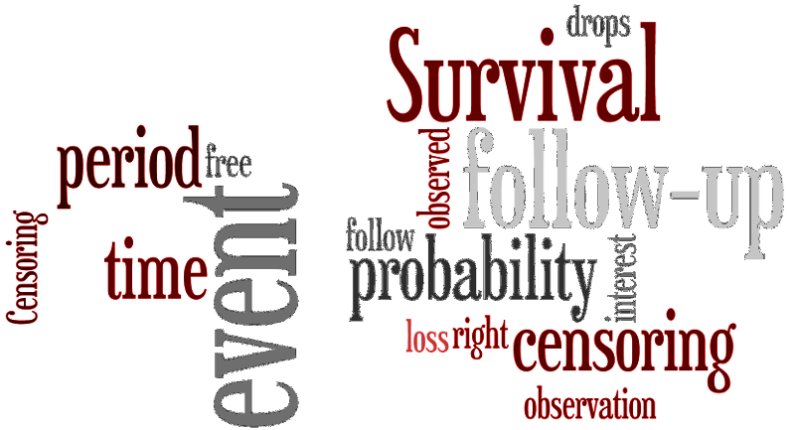
What is
Survival Analysis?
Image Source

Slide 7
Goal
Exposure
Event
Time-to-event
To estimate the time to the event of interest for a new instance given the predictors

Slide 8
Unique
Features
Time-to-event variables are always non-negative and continuous
The distributions are often skewed
Assumptions of normality are not applicable
Complete data for all the participants may not be available

Slide 9

Scenario
Example:
A study was conducted with 10 participants over 10 years to monitor if they encounter heart attack (Myocardial Infarction) or not.
M.I.
Drop out
Observations:
One person dies while the study was ongoing
Two persons suffer the event of interest
Three people dropped out of the study
M.I.
What is the likelihood that a participant suffers in 10 years?
Drop out
Is it 2/10?
Is it 3/7?
Drop out
Death
1
2
3
4
5
6
7
8
9
10
Time in years
Example Source

Slide 10
Censoring
Why?
The study ends before the time to event
A participant drops out
Assumptions
The participants whose data were censored would have same distribution of times to event if they were observed

Slide 11
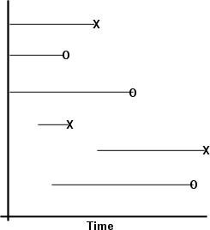
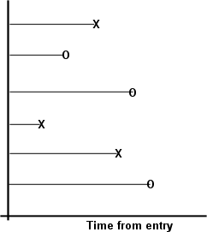
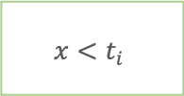
Censoring
X means an event occurred
O means that the subject was censored
Right Censoring
$$x<t_{i}$$

Slide 12
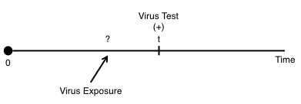
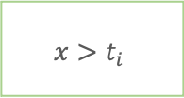
Censoring
Left Censoring
$$x>t_{i}$$

Slide 13
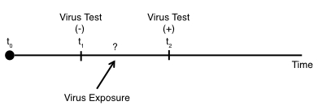
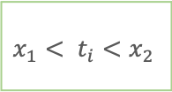
Censoring
Interval Censoring
$$x_{1}< t_{i}<x_{2}$$

Slide 14
Truncation
Observations are excluded by the virtue of their time-to-event

Slide 15
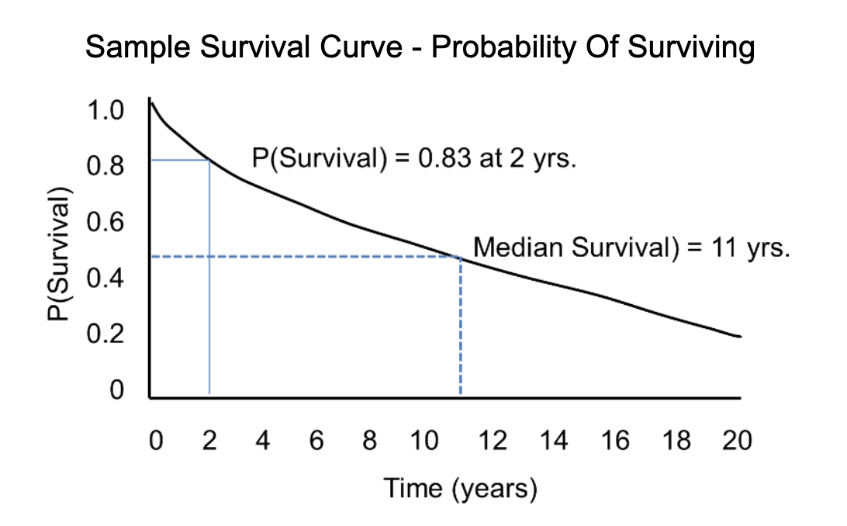
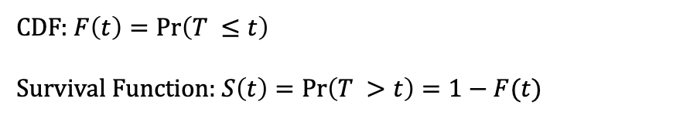
Survival
Function
As t increases, the S(t) should decrease
S(0)=1
S(∞)=0
CDF: $F\left(t\right)=\operatorname{Pr}\left(T ≤t\right)$
Survival Function: $S\left(t\right)=\operatorname{Pr}\left(T >t\right)=1−F(t)$

Slide 16
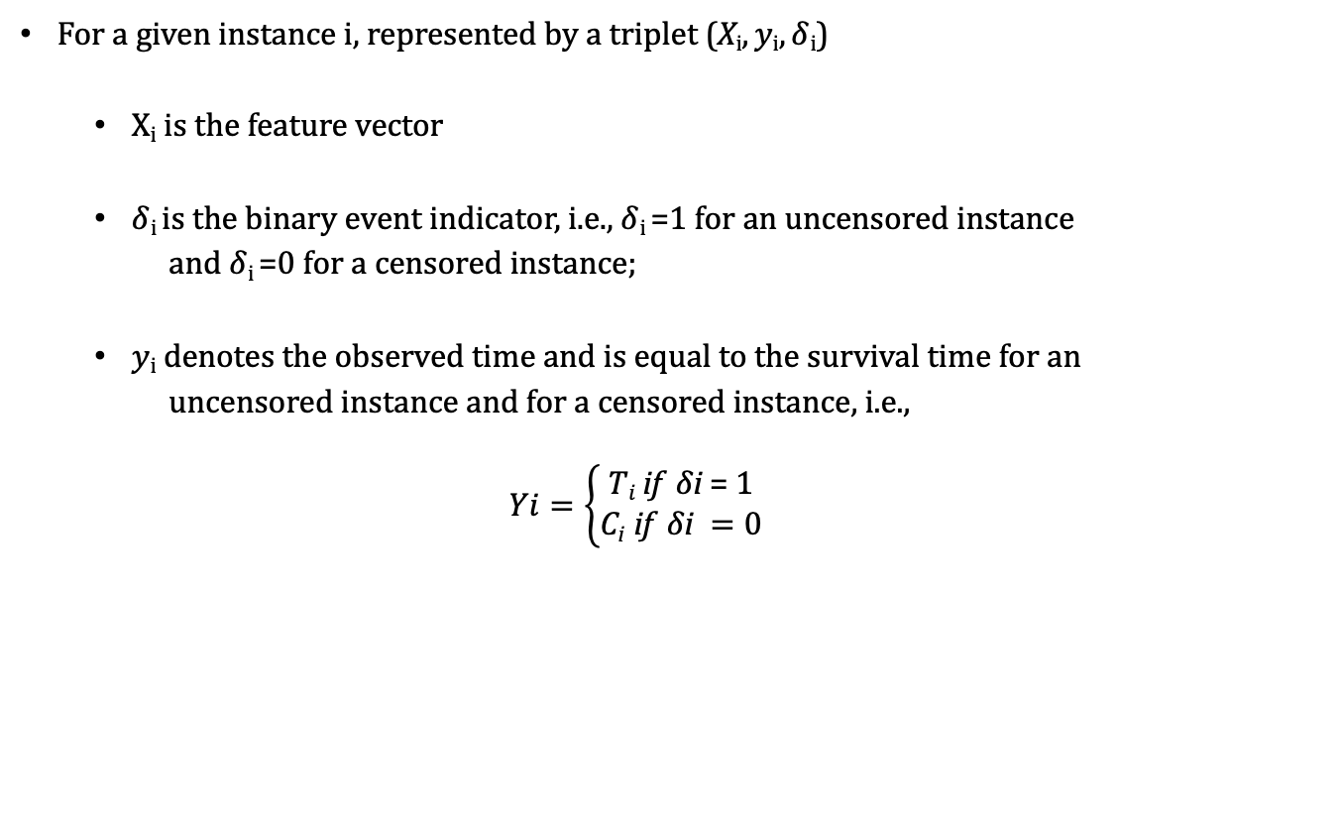
Problem Formulation
For a given instance$\text{i}$, represented by a triplet (X$i, yi, δ$_{i})
X$i$ is the feature vector
$δ$_{i} is the binary event indicator, i.e., $δ$_{i} =1 for an uncensored instance
and $δ$_{i} =0 for a censored instance;
$yi$ denotes the observed time and is equal to the survival time for an
uncensored instance and for a censored instance, i.e.,
$$Yi=\left\{\begin{aligned}Ti \text{if} δ\text{i} \text{=} \text{1} \\ \text{C}\text{i} \text{if} δ\text{i} =0\end{aligned}\right.$$

Slide 17
Model Landscape
Survival Analysis Methods
Non-Parametric
Semi-Parametric
Parametric
Machine Learning
Other Topics
Kaplan-Meier
Nelson-Aalen
Life Table
Cox- Regression
Basic Cox-PH
Penalized Cox
Time Dependent Cox
Cox Boost
Lasso-Cox
Ridge-Cox
OSCAR-Cox
EN-Cox
Linear Regression
Accelerated Failure Time
Tobit
Buckley James
Penalized Regression
Weighted Regression
Structured Regularization
Survival Trees
Bayesian Methods
Neural Networks
Support Vector Machine
Ensemble
Advanced Machine Learning
Naive Bayes
Bayesian Networks
Random Survival Forests
Bagging Survival Tress
Active Learning
Transfer Learning
Multi Task Learning
Early Prediction
Data Transformation
Complex Events
Un-censoring
Calibration
Competing Risks
Recurrent Events

Slide 18
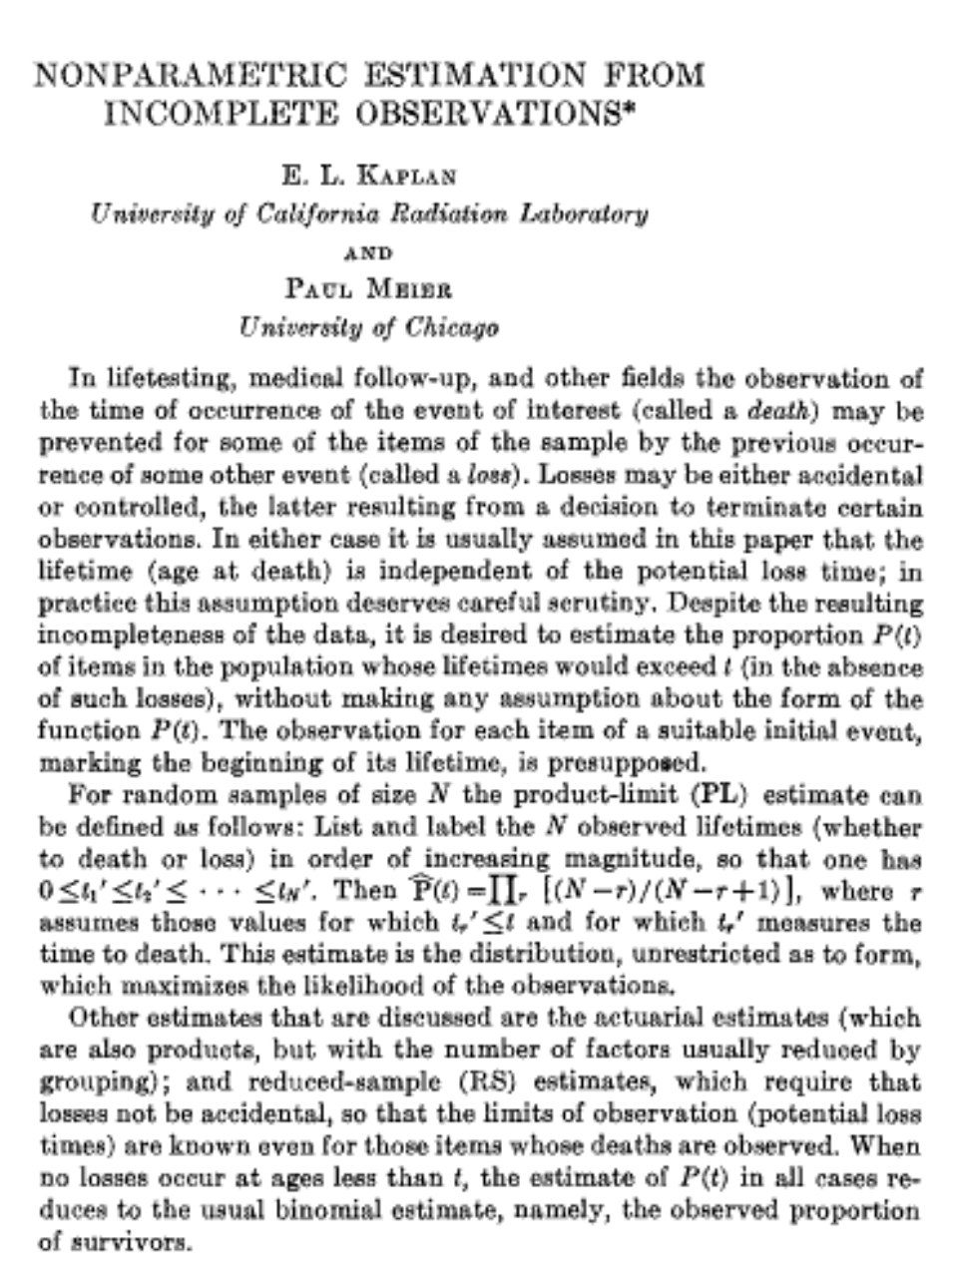

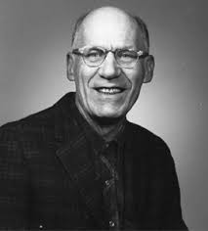
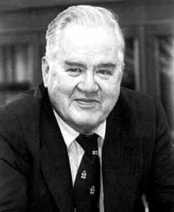
Kaplan-Meier Estimator
Edward L Kaplan
Paul Meier
Nonparametric Estimation from incomplete observations
E L Kaplan & Paul Meier
Journal of the American Statistical Association, 1958
John Tukey

Slide 19
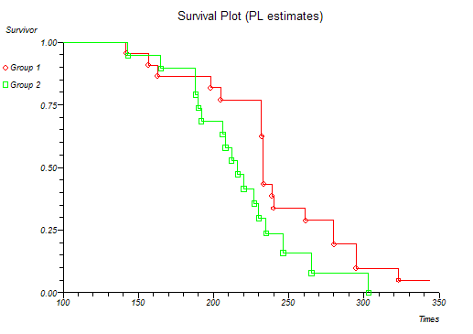

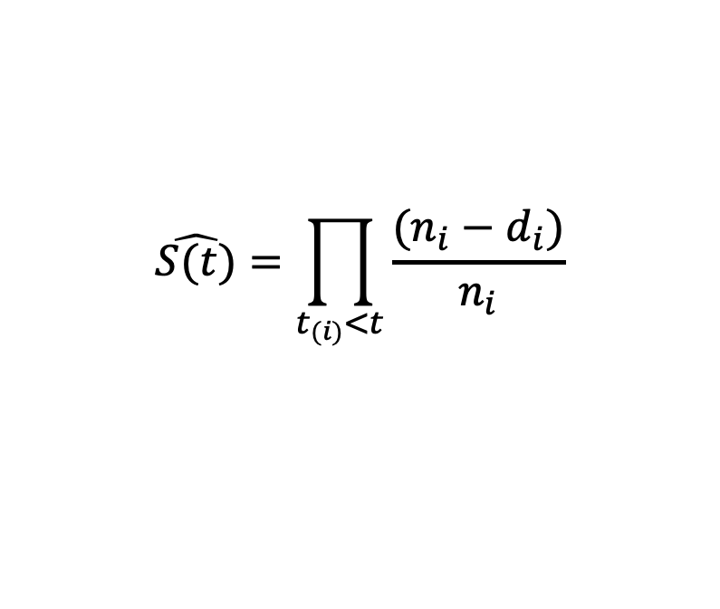
Kaplan-Meier Estimator
Calculate survival probability by re-estimating the same each time the event of interest occurs
$$\hat{S(t)}=\prod_{t_{(i)}<t}{\frac{(n_{i}−d_{i})}{n_{i}}}$$
$n_{i}=number at risk$,
$$d_{i}=number at deaths$$
Image source

Slide 20
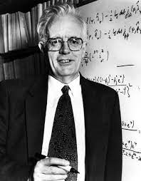
Cox Proportional Hazard Regression Analysis
Assess effect of multiple covariates on survival
Semiparametric
Can handle both continuous and categorical predictor variables

Slide 21

What is Clearance?
Image Source
To clear out the products which are out-of-style, out-of-season or did not sell and to make space for newer products
Generally, lasts for a few weeks
Prices are monotonically decreasing

Slide 22

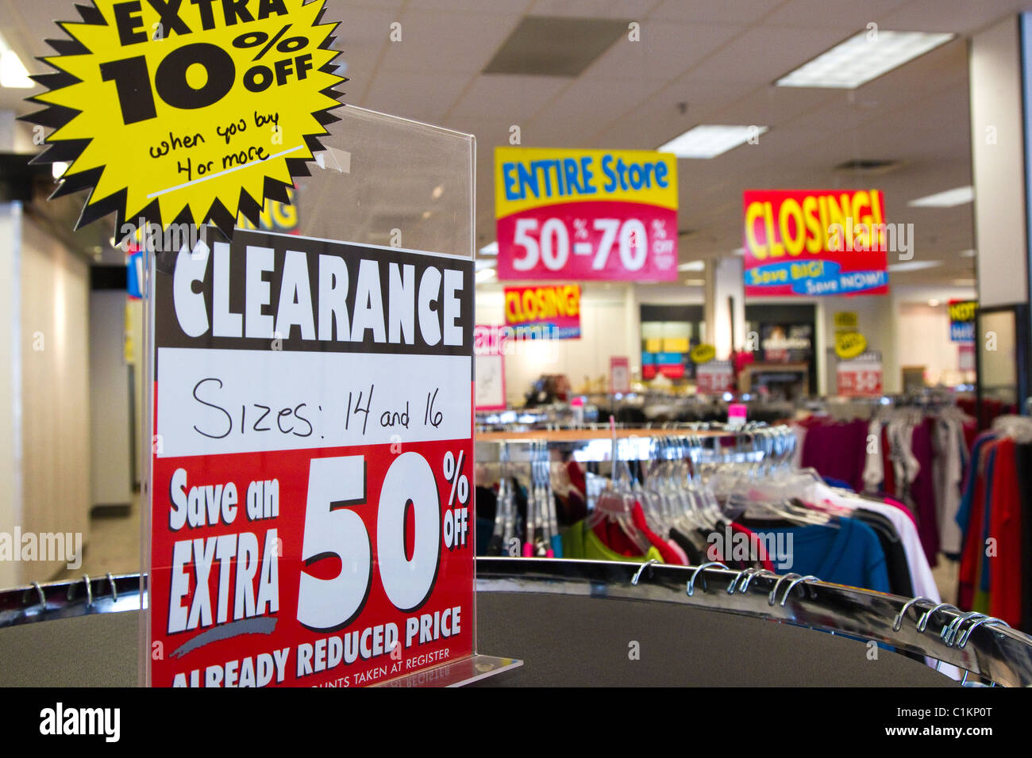
Difference between Sales/Promotion and Clearance?
Image Source
Image Source
Promotional Activity
Attract more customers
Attain a higher turnover rate
Holiday, Back-to-School, Summer
Activity for end of product lifecycle
Clear the unwanted inventory
Prices are monotonic decreasing
Out-of-season, out-of-style products

Slide 23
Three Questions of importance
1.
Which products/items are ready for clearance?
2.
When is it the right time to start clearance?
3.
For how long the clearance activity should go on for the items?

Slide 24
Journey of a Product
Clearance
Onset
Regular Sales
Promotions
Regular Sales
Clearance
End of inventory or Salvage
Stages of the product life cycle

Slide 25
Product Hierarchy
Division
Clothing
Group
Women’s
Department
Dresses
Class
Pants
Subclass
Casual
Men’s
Kids
Shoes
Bottoms
Item
Item ids
Skirts
Formal
Division | Group | Department | Class | Subclass
Clothing | Women's | Dresses | A-line | Women's A-line White Dress
Clothing | Women's | Dresses | Formal | Women's Formal Beige Dress
Clothing | Women's | Officewear | Pants | Women's Office-wear Navy Blue Trousers
Clothing | Women's | Officewear | Suits | Women's Office-wear Black Suit
Clothing | Women's | Officewear | Suits | Women's Office-wear Grey Suit
Clothing | Women's | Shoes | Sandals | Women's Casual Printed Sandals
Clothing | Women's | Bottomwear | Pants | Women's Pull on Linen Trousers
Image Inspiration Source

Slide 26

Case Study
Regular
sales
Regular
sales
Promotion
Regular
sales
Clearance
End of inventory
Regular
sales
Regular
sales
Promotion
Clearance
Regular
sales
Regular
sales
Promotion
Clearance
End of inventory
Study Period: 21 weeks
1
2
3
4
…
19
20
21

Slide 27
Problem Statement
Regular
sales
Regular
sales
Promotion
Regular
sales
Clearance
End of inventory
23 subclasses from one division have been followed for 21 weeks
Regular
sales
Regular
sales
How long these items are going to be selling once clearance starts?
Promotion
Clearance
Regular
sales
Regular
sales
Promotion
Clearance
End of inventory
Study Period: 21 weeks
1
2
3
4
…
19
20
21

Slide 28
Problem Statement
End of inventory
Clearance onset
Subclass | study_strt | study_end | clr_strt_dt | clr_end_dt | survival_time | inv_fin
Comfort Side Pocket Leggings | 05/05/19 | 29/09/19 | 27/07/19 | 16/09/19 | 7.3 | 1
Tops | 05/05/19 | 29/09/19 | 10/08/19 | 06/09/19 | 3.9 | 1
Pencil Skirt Office | 05/05/19 | 29/09/19 | 16/08/19 | 09/09/19 | 3.4 | 1
Denim Jeans | 05/05/19 | 29/09/19 | 27/05/19 | 21/08/19 | 12.3 | 1
Skinny Jeans | 05/05/19 | 29/09/19 | 11/08/19 | 17/09/19 | 5.3 | 0
Yoga Leggings | 05/05/19 | 29/09/19 | 12/09/19 | 29/09/19 | 2.4 | 1
Denim Shirt Dress | 05/05/19 | 29/09/19 | 05/07/19 | 27/07/19 | 3.1 | 0
Square Neck Top | 05/05/19 | 29/09/19 | 12/09/19 | 24/09/19 | 1.7 | 1
T-Shirt Dress | 05/05/19 | 29/09/19 | 22/05/19 | 22/09/19 | 17.6 | 1
Bodycon Dress | 05/05/19 | 29/09/19 | 27/08/19 | 08/09/19 | 1.7 | 0
Pull-on Linen Trousers | 05/05/19 | 29/09/19 | 22/09/19 | 24/09/19 | 0.3 | 1
Exposure
Event
Time-to-event
Censored

Slide 29
Exploratory Analysis
The sales journey of the subclass Pull-on Linen Trousers
Overall declining trend
Time between clearance onset and the end of inventory is less than a week

Slide 30
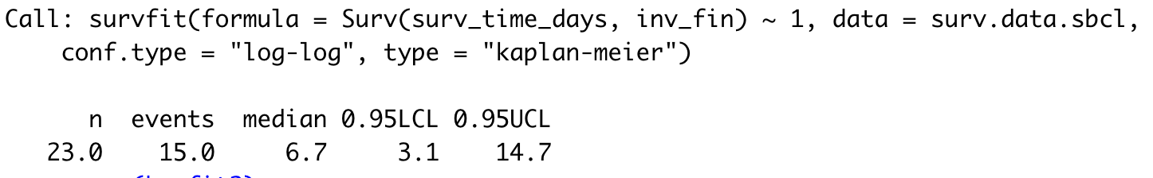
Results: Kaplan Meier Plot
Total 23 subclasses were in the study
Median number of weeks before some subclass could end the inventory is 6.7 ~ 7 weeks
Lower and upper limits are given for the same

Slide 31
Results: Kaplan Meier Plot for two brands
Two brands – National and Private
Median number of weeks before some subclass could end the inventory for each brand is given
Log-rank test is to compare between two KM-plots

Slide 32
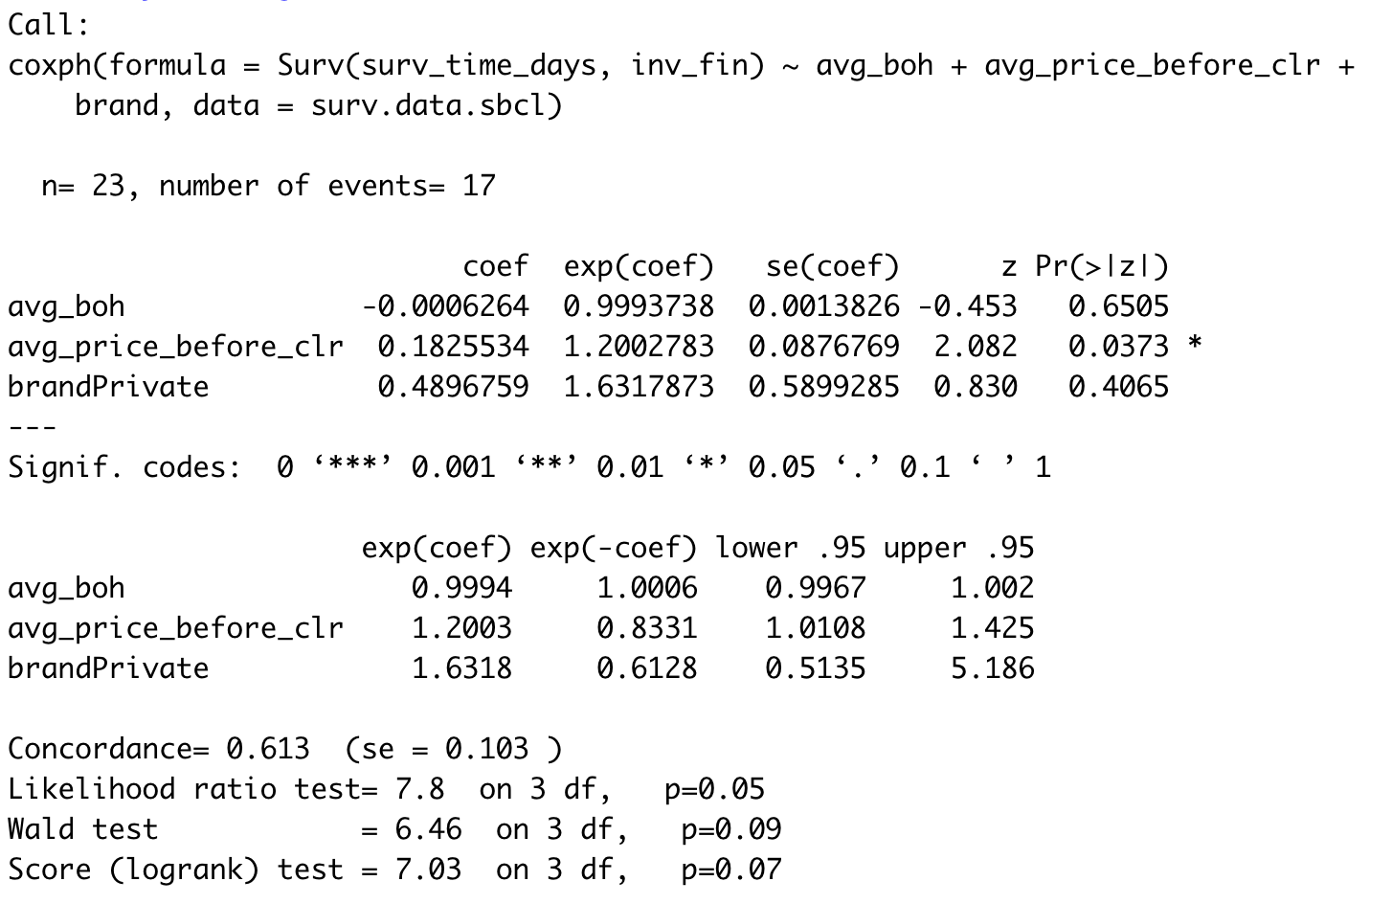
Results: Cox Regression
Reference brand group - National
Significant variable is avg_price_before_clr
Concordance score to state how well the model predicted

Slide 33
Know
Your
Why?
01
Insights
02
Revenue Generation
03
Customer Engagement

Slide 34

Software
Survival
Survminer

Slide 35
Thank You

Slide 36
References
Data Mining, Doug Alexandar, link
Data Rich, Information Poor, University of Minnesota, Information Systems, Link
What is big data? Link
Machine Learning for Survival Analysis: A Survey, Ping Wang, Yan Li, Chandan K. Reddy, Virginia Tech, Link
Survival Analysis, Lisa Sullivan, PhD, Professor of Biostatistics, Boston University School of Public Health, Link
The Determinants of Soccer Player Substitutions: A Survival Analysis of the Spanish Soccer League, Julio Del Corral, Carlos Pestana Barros, Juan Prieto-Rodriguez, Link
Pancreatic Cancer: A survival analysis study in Oklahoma, Wahutu, M., Vesely, S. K., Campbell, J., Pate, A., Salvatore, A. L., & Janitz, A. E. (2016). The Journal of the Oklahoma State Medical Association, 109(7-8), 391. link
Wohlfahrt-Veje, C., Mouritsen, A., Hagen, C. P., Tinggaard, J., Mieritz, M. G., Boas, M., ... & Main, K. M. (2016). Pubertal onset in boys and girls is influenced by pubertal timing of both parents. The Journal of Clinical Endocrinology & Metabolism, 101(7), 2667-2674. link
Rodrigues, A. S., Calsavara, V. F., Silva, F. I., Alves, F. A., & Vivas, A. P. (2018). Use of interval-censored survival data as an alternative to Kaplan-Meier survival curves: studies of oral lesion occurrence in liver transplants and cancer recurrence. Applied Cancer Research, 38(1), 16. link
Gilbert, S. L., Lindberg, M. S., Hundertmark, K. J., & Person, D. K. (2014). Dead before detection: addressing the effects of left truncation on survival estimation and ecological inference for neonates. Methods in Ecology and Evolution, 5(10), 992-1001. Link
Kalbfleisch, J. D., & Lawless, J. F. (1989). Estimating the incubation time distribution and expected number of cases of transfusion‐associated acquired immune deficiency syndrome. Transfusion, 29(8), 672-676. Link
In-season retail sales forecasting using survival models, M Hattingh, DW Uys, Orion ISSN 0529-191-X, 2014, Volume 30(2) pp 59-71
Optimal pricing in retail: a Cox regression approach, Rudi Meijer, Sandjai Bhuali, International Journal of Retail & Distribution Management, Vol 41, No 4, 2013, pp 311-320
Survival analysis, Zed Statistics, Link
Webinar Overview of Cox Proportional Hazard Models Cox Regression 11 29 18, Omega Statistics, Link
What is the difference between a Sale and a Clearance? Link
Retail Merchandising Foundation Cloud Service Foundation Data Guide, Oracle Help Center, Link
Oracle Retail Insights User Guide, Release 16.0.203, E89922-01, Dimensions and Attributes, Link
Survival Package, R Software, Link
Survminer package, R Link

